Slide 1
compare heterogeneity in multi-omic data
Luyi Tian
Ritchie Lab & Naik Lab
Oz Single Cells 2019
Computational Challenge

Slide 2
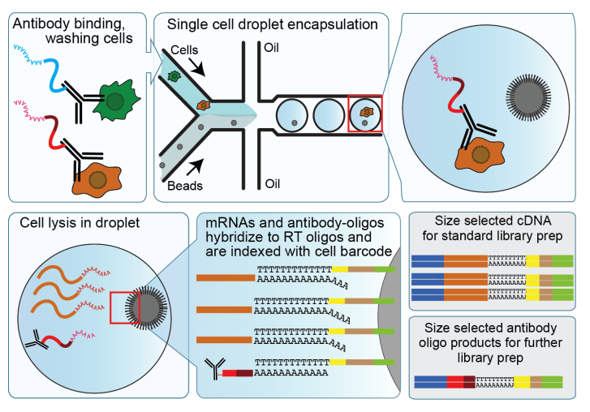
CITE-seq measures the surface protein marker and transcriptome level for the same cell
RNA
 | cell1 | cell2
gene1 | x | x
gene2 | x | x
ADT
 | cell1 | cell2
antibody1 | x | x
antibody2 | x | x
https://cite-seq.com/

Slide 3
The data
Data from Swarbrick Lab (Garvan Institute)
Human metastatic lymph node with spiking in mouse cells (3T3).
96 CITE-seq antibodies

Slide 4
Quality control

Slide 5
Quality control
Set threshold on human RNA, ADT count and
MT percentage
1926 cells after quality control

Slide 6
Seurat clustering
UMAP and clustering RNA
UMAP and clustering ADT
B
T cell population
CD3/CD4/CD8
T
DC cell population
CD11c
DC
B cell population
CD19
Stuart et al. Cell 2019

Slide 7
?

Slide 8
Clustering entropy
Metrics originally developed for evaluating clustering performance (Tian et al. Nature Methods 2019)
but can also compare two clustering assignment in general

Slide 9
Clustering entropy
Clustering assignment A
Clustering assignment B
Clustering entropy: 1.5
1
3
Heterogeneity in B > Heterogeneity in A
Clustering entropy: 0
2
3
3
Heterogeneity in B <= Heterogeneity in A

Slide 10
Seurat clustering in multi-resolutions
RNA
ADT
0.1
2.4
Clustree package. Zappia et al. GigaScience 2018

Slide 11
Transcriptome heterogeneity in ADT clusters
B
T
DC

Slide 12
Visualization heterogeneity in one-sense plots
B
T
DC
Idea from: Cheng et al. J Immunol. 2016; Shalin Naik

Slide 13
Cancer!
OX40, HER2, CD66b

Slide 14
Everything is publicly available.
Github: github.com/LuyiTian/OzSingleCells_Challenge_2019
RNA <--> ADT
RNA <--> patient id
RNA <--> genotype
RNA <--> epigenetic markers

